Slide 1



Sales Insight
View in Power BI
Last data refresh:
12/5/2021 1:56:08 PM UTC
Downloaded at:
12/15/2021 7:45:52 AM UTC

Slide 2
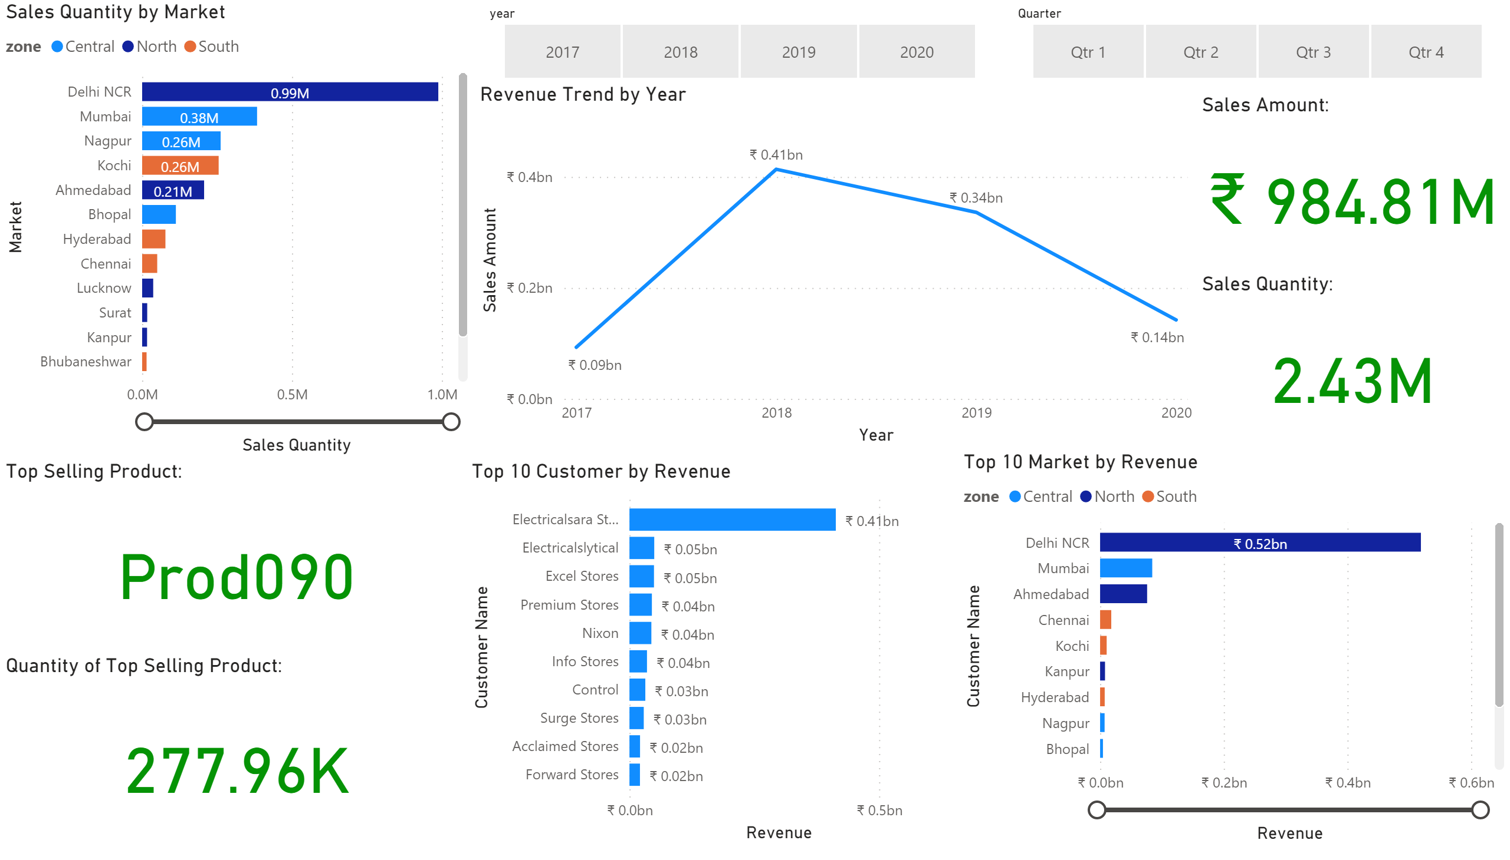
Sales Insight
Notes:
Sales Quantity by Market
No alt text provided.
Revenue Trend by Year
No alt text provided.
slicer
No alt text provided.
slicer
No alt text provided.
Sales Amount:
No alt text provided.
Sales Quantity:
No alt text provided.
Quantity of Top Selling Product:
No alt text provided.
Top Selling Product:
No alt text provided.
Top 10 Customer by Revenue
No alt text provided.
Top 10 Market by Revenue
No alt text provided.

Slide 3
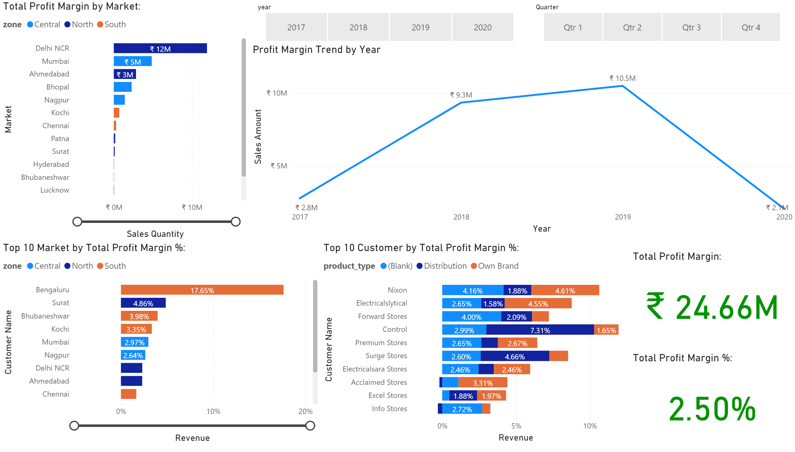
Sales Profit Insight
Notes:
Total Profit Margin by Market:
No alt text provided.
Profit Margin Trend by Year
No alt text provided.
slicer
No alt text provided.
slicer
No alt text provided.
Total Profit Margin %:
No alt text provided.
Total Profit Margin:
No alt text provided.
Top 10 Customer by Total Profit Margin %:
No alt text provided.
Top 10 Market by Total Profit Margin %:
No alt text provided.

